Slide 1
TECH SUPPORT QUICK ONBOARDING GUIDE
V1
A year from now you may wish you had started today – Karen Lamb
17-June-2021

Slide 2
AGENDA
01
WELCOME MESSAGE
04
KEY TOOLS ACCESS
02
TECH SUPPORT OVERVIEW
05
KEY POLICY & PROCEDURES
03
TECH SUPPORT CORE TEAM
06
DATA SECURITY TRAINING

Slide 3
WELCOME MESSAGE
01
Congratulations on becoming the newest member of Verticurl family! We hope you find your new role rewarding and challenging. On-behalf of our entire Tech Support team I welcomes you aboard, hope to have a long and successful journey together.

Slide 4
TECH SUPPORT OVERVIEW
02
“Can’t remember your email password. Just let us know, we will EMAIL you a new password.” – Following Policies & Guideline is Our Bloodline 😉

Slide 5

02. TECH SUPPORT OVERVIEW
MISSION: WE STRIVE HARD TO MAKE SURE YOU WILL FORGET THERE IS A TECH SUPPORT TEAM & AS A RESPONSIBLE EMPLOYEE YOUR NEED TO CONTACT US ATLEAST ‘ZERO’ TIME PER DAY
1
2
3
WHEN TO CONTACT
US?
WHO WE ARE?
WHAT WE DO?
We are the proud technical backbone of VERTICURL for all IT & related services.
We eat APPLE, We speak LEET, We view through WINDOW, We stay in CLOUD & When in trouble we PING you to ZOOM you out.
We are available Monday to Friday during LIGHT or DARK mode.
We are also available on Sat & Sun for CRITICAL and PARTY requests ONLY.
4
HOW TO CONTACT US?
We highly prefer TICKETING TOOL as primary channel.

Slide 6
TECH SUPPORT CORE TEAM
03
“Coming together is a BEGINNING. Keeping together is PROGRESS. Working together is SUCCESS.” - Henry Ford

Slide 7
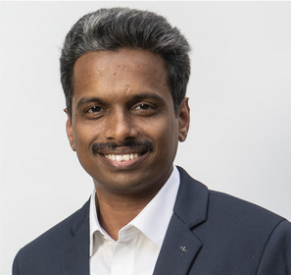

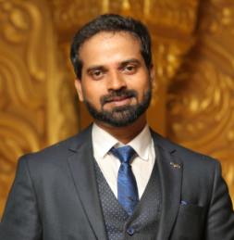

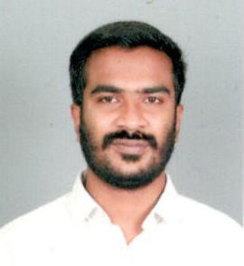

03. TECH SUPPORT CORE TEAM
SRINI
SASI
SURESH
THATWA
Director IT
Manager
Sr. System Engineer
System Engineer
SREE
HARI
System Administrator
System Engineer

Slide 8
KEY TOOLS ACCESS
04
As part of Onboarding, we provide you some key tools access which you will be using day to day.

Slide 9






04. KEY TOOLS ACCESS
01
05
07
03
G-SUIT ACCESS
accounts.google.com
INTERNAL BULLETIN BOARD
bulletinboard.verticurl.com
KEY POLICIES
bit.ly/2UfLj1G
PM TOOL (ZOHO)
projects.zoho.in
02
04
06
TICKETING SYSTEM
techsupport.verticurl.com
L&D verticurl.lessonly.com
DATA SECURITY TRAINING
inside.wpp.com

Slide 10
KEY POLICY & PROCEDURES
05
In any organization POLICY will set the expectation for employee behaviors and the PROCEDURE outlines the steps for it. Together, policies and procedures provide a roadmap for effective day-to-day operations.

Slide 11
05. KEY POLICY & PROCEDURES
URL: https://bit.ly/2UfLj1G
01
ACCEPTABLE USE POLICY – Streamlined extract from various other key policies, which is an user-friendly version.
02
DATA HANDLING POLICY – The policy describes how data must be collected, handled, stored and transferred so to protect them all the time.
03
USER ACCESS MANAGEMENT – Policy defines Onboarding, Role change, Exit & privileged access management within Verticurl.
04
VERTICURL INTERNAL SECURITY– Single point policy document that hold almost all other Key guideline and procedures.

Slide 12
DATA SECURITY TRAINING
06
Verticurl takes data privacy very seriously, so we have created a dedicated training course to help you understand the risks and ways to mitigate them effectively.

Slide 13
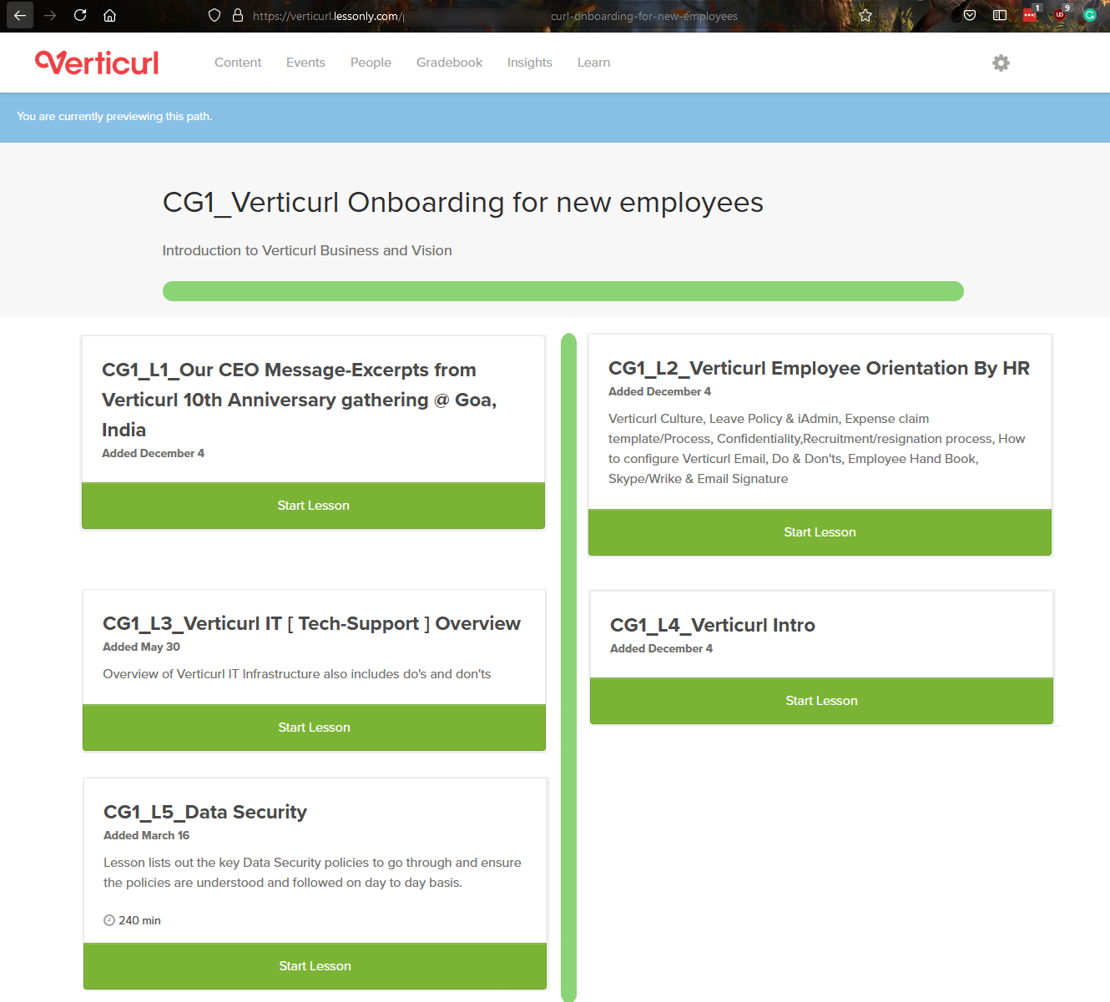
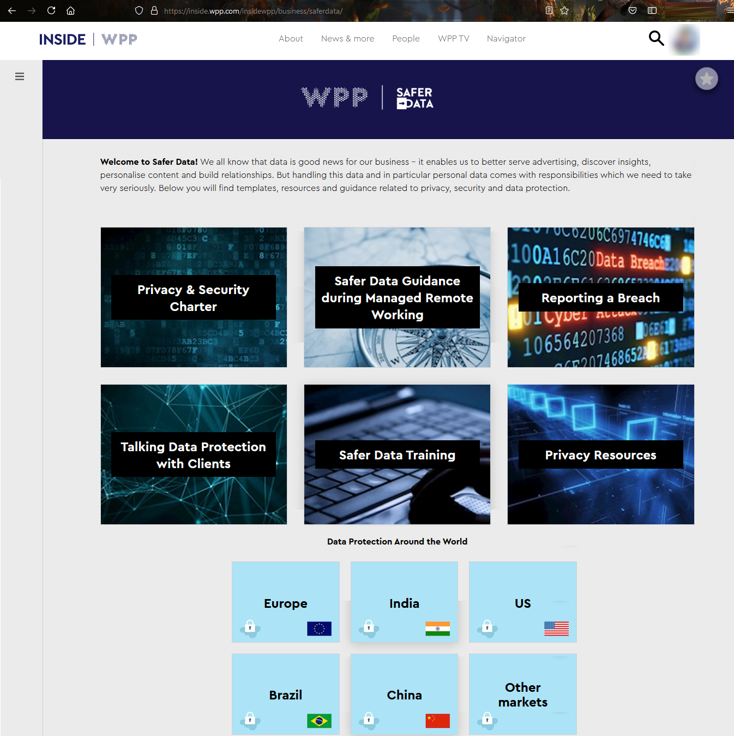
06. DATA SECURITY TRAINING
VERTICURL L&D PLATFORM
WPP SAFER DATA TRAINING

Slide 14
Q&A

Slide 15
Thank You
"I want to look back on my career and be proud of the work and be proud that I tried everything." —Jon Stewart

